Slide 1
BITS Pilani presentation
K.Anantharaman
Faculty CS Department
kanantharaman@wilp.bits-pilani.ac.in
19-Jan-25
Agile SW Process SE ZG544 S2-24-25

Slide 2
SE ZG544 S2-24-25 , Agile Software Processes Lecture No. 1, Module-1 - Agile Methods - An Introduction
19-Jan-25
Agile SW Process SE ZG544 S2-24-25

Slide 3
Introduction
Faculty introduction
Email Id : kanantharaman@wilp.bits-pilani.ac.in
e-learn portal: https://elearn.bits-pilani.ac.in/
Course Handout
19-Jan-25
Agile SW Process SE ZG544 S2-24-25

Slide 4
19-Jan-25
Agile Software Process SE ZG544 S2-24-25

Slide 5
Poll
POLL
Objective:
Online poll to understand the expectations of students attending this course.
Reference Material: Introduction to Software Development.pdf
(Find it in the MS teams- Class material directory
19-Jan-25
Agile Software Process SE ZG544 S2-24-25

Slide 6
Module-1 – Topics
Traditional software development practices
Need for Agile Methods
Benefits of Agile Methods
19-Jan-25
Agile Software Process SE ZG544 S2-24-25

Slide 7
Basic Project Management concepts
What is a Project?
Definite Start-End date, Temporary, Scope(Produce Specific result) , Budget/Effort – Example: Building a house
Project Management Life Cycle Phases
Initiation, Planning, Execution, Closeout, Monitoring & Control
System Development Life Cycle/phases (SDLC)
Requirements, Design, Construction, Implementation
19-Jan-25
Agile SW Process SE ZG544 S2-24-25

Slide 8
What is a Project?
A project is a planned program of work that requires a definitive amount of time, effort, and planning to complete.
Projects have goals and objectives and often must be completed in some fixed period of time and within a certain budget.
Development Project
Maintenance or Support Project (Operational work)
19-Jan-25
Agile Software Process SE SG544 S2-24-25

Slide 9
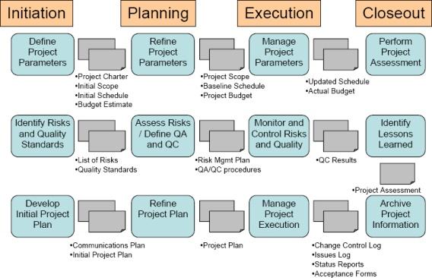
Project Management Phases
https://www.pmi.org/learning/library/project-managing-sdlc-8232
19-Jan-25
Agile Software Process SE SG544 S2-24-25

Slide 10
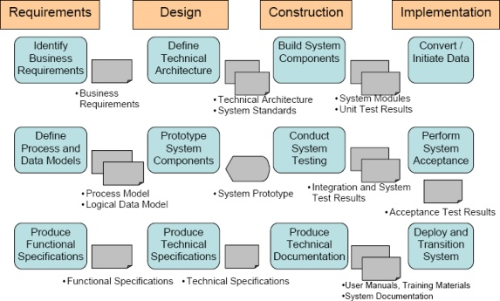
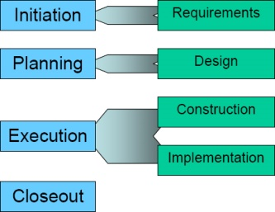
System Development Phases (Engineering activities)
https://www.pmi.org/learning/library/project-managing-sdlc-8232
19-Jan-25
Agile Software Process SE SG544 S2-24-25

Slide 11
Project Management Model
Water Fall Model and Agile
Agile SW Process SE ZG544 S2-24-25
19-Jan-25
Agile SW Process SE ZG544 S2-24-25

Slide 12
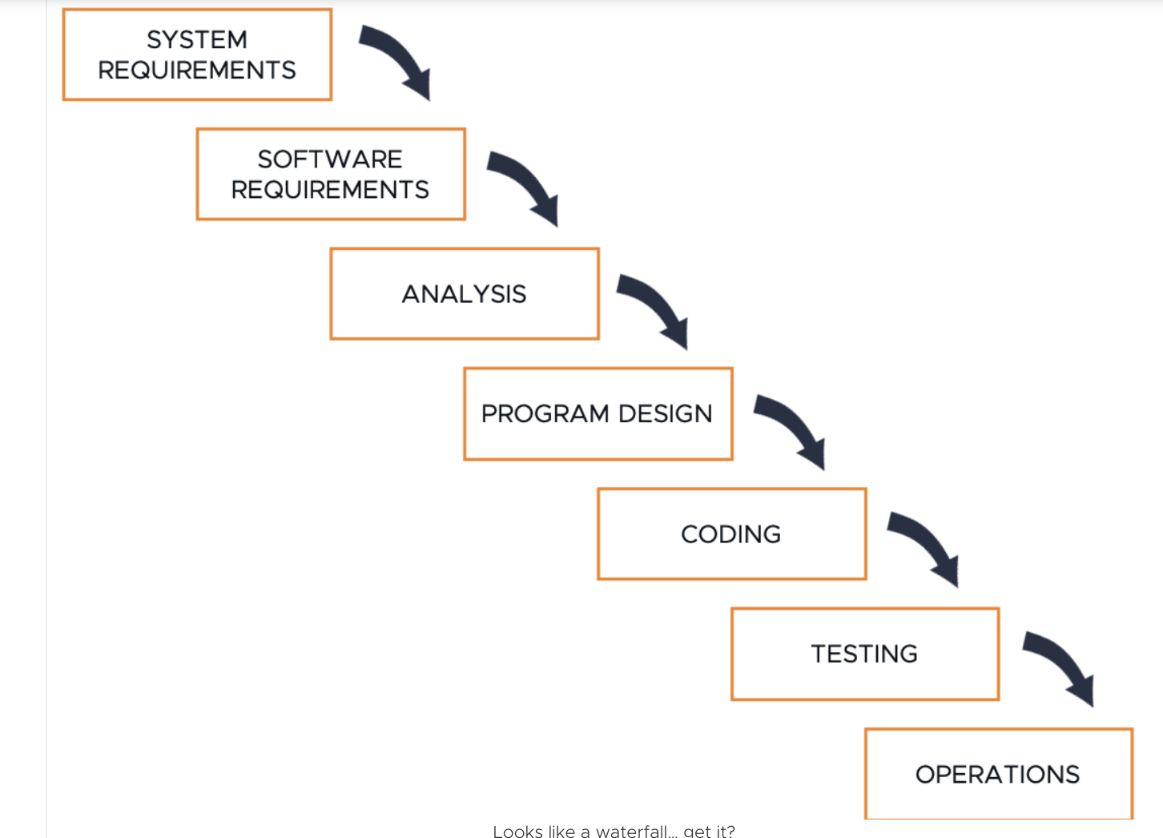

Waterfall Approach to Software Development
Waterfall/Predictive/Traditional
( Different terminologies that refer to same approach)
Phases & Phase Gate
Move to the next phase only when the prior one is complete — hence, the name waterfall.
Origin from manufacturing like production plant
Upfront Planning
Detailed documentation
Scope of work is generally fixed.
Output of a phase becomes input to next phase
Include well defined checklists, process and tools
Customer Release-Value realization
https://www.beyond20.com/blog/when-to-use-agile-and-when-to-use-waterfall-when-managing-projects/
19-Jan-25
Agile Software Processes SE SG544 S2-24-25

Slide 13
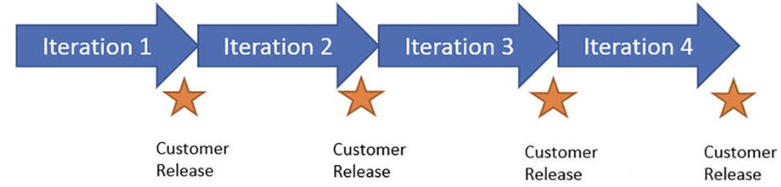
Agile Approach to Software Development
Agile/Adaptive/Iterative & Incremental
( Different terminologies that refer to same approach)
Sprints & Sprint Review
Design, Coding and Testing in each iteration in any order
Origin from lean manufacturing
Rolling Wave Planning
Less documentation
Negotiable feature sets
Minimum process and tools
Customer Release-Value realization in each iteration
19-Jan-25
Agile SW Processes SE ZG544 S2-24-25

Slide 14
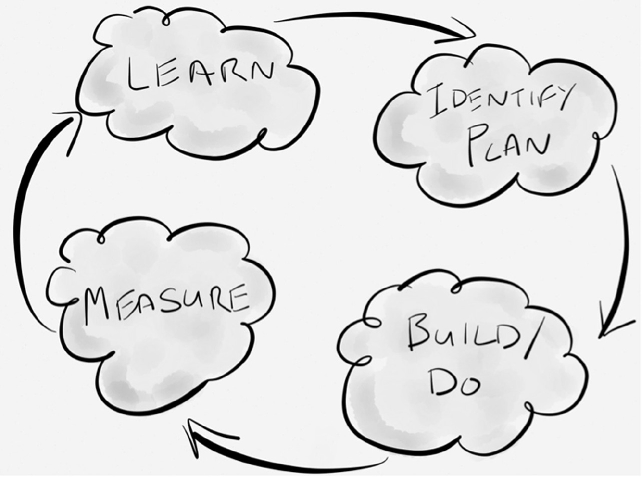
Empirical Process Control
Inspection
inspect the product being created and how it is being created
Adaption
adapt the product being created or the creation process if required
Transparency
ensure everyone can easily see what is happening
PDCA Cycle
19-Jan-25
Agile Software Process SE ZG544 S2-24-25

Slide 15
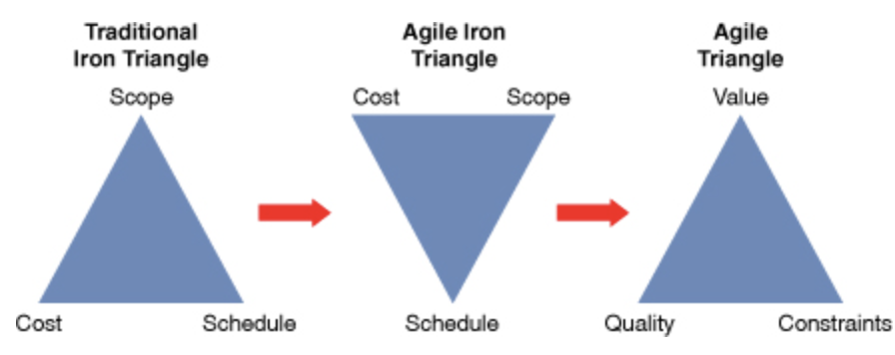
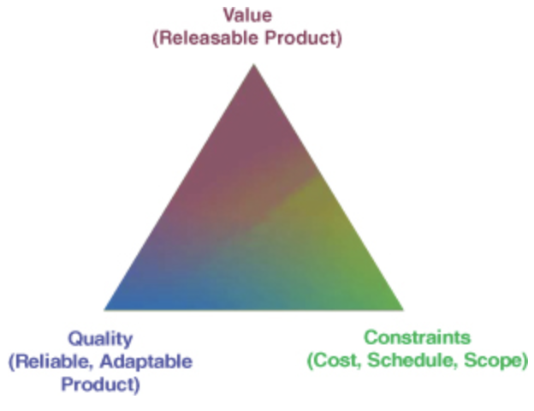
Iron Triangle of Project management The Evolution to an Agile Triangle
Fixed
Variable
Fixed
Variable
Fixed
Fixed
Variable
(Scope, Time,Cost)
Reference: Agile Project Management: Creating Innovative Products, Second Edition, Jim Highsmith, Published by Addison-Wesley Professional
19-Jan-25
Agile Software Processes SE ZG544 S2-24-25

Slide 16
Questions?
Link – 5 Sections
19-Jan-25
Agile Software Process SE ZG544 S2-24-25

Slide 17
Advantages and Disadvantages of Waterfall
Disadvantages:
Error propagation
Missing requirements
Error correction is costly
Late customer feedback
Advantages:
Sequential, Upfront planning
Good Documentation
Scope of work is generally fixed
19-Jan-25
Agile SW Process SE ZG544 S2-24-25

Slide 18
Advantages and Disadvantages of Agile Model
Advantages:
Early delivery of business value
Continuous improvement
Scope flexibility
Team input
Delivering well-tested products
Disadvantages:
Poor Resource planning
Less Documentation
Fragmented output
19-Jan-25
Agile SW Process SE ZG544 S2-24-25

Slide 19
Application of Waterfall Model
Most common Project Management approach
Surpassed by Agile approach after 2008.
Simple and small systems.
Enchantments to software systems
Mission critical systems.
19-Jan-25
Agile Software Process SE ZG544 S2-24-25

Slide 20
Application of Waterfall and Agile Model
Fast Changing deliverables - New Technology Emerging projects
Projects without clear requirements in the beginning
New Product Development Projects
Early Visibility, Quality, Risk identification
19-Jan-25
Agile Software Process SE ZG544 S2-24-25

Slide 21
Need for Agile Methods
19-Jan-25
Agile Software Process SE ZG544 S2-24-25

Slide 22
Traditional Software Development Approaches
Traditional Software Development Model – Waterfall Model
19-Jan-25
Agile Software Process SE SG544 S2-24-25

Slide 23
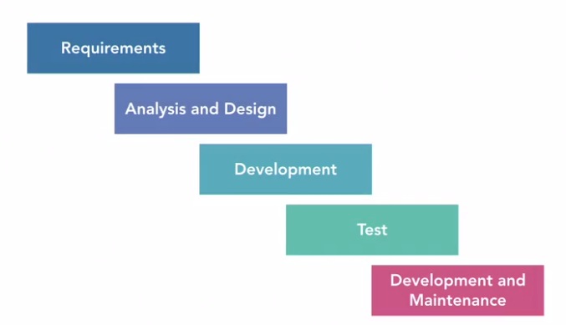
Waterfall Approach
Move to the next phase only when the prior one is complete — hence, the name waterfall.
Origin from manufacturing like production plant
Upfront Planning
Detailed documentation
Scope of work is generally fixed.
Output of a phase becomes input to next phase
Include well defined checklists, process and tools
https://www.lynda.com/Developer-tutorials/Software-Development-Life-Cycle-SDLC/5030981-2.html
19-Jan-25
Agile Software Process SE SG544 S2-24-25

Slide 24

Issues with Waterfall approach
Error in one phase will propagate to next phase
Missing requirements will result in missing software feature
Error correction is costly if it is detected at later phase
Customer does not get to see the product before the early testing phase which is usually two-thirds the way through the product time line.
https://www.lynda.com/Developer-tutorials/Software-Development-Life-Cycle-SDLC/5030981-2.html
19-Jan-25
Agile Software Process SE SG544 S2-24-25

Slide 25
Issues with Waterfall approach …
You could be in the Deployment and Maintenance phase when you could realize that the product you are building was no longer viable due to change in market conditions, or organizational direction, or changed computer landscape
(OR) You could realize that the product had a major architectural flaw that prevented it from being deployed.
In other words, your product development initiative could completely fail after a lot of money and time had been spent on it.
https://www.lynda.com/Developer-tutorials/Software-Development-Life-Cycle-SDLC/5030981-2.html
19-Jan-25
Agile Software Process SE SG544 S2-24-25

Slide 26
Impact of Waterfall
Project failures
Many organizations treated this failure as if there was a failure in a production factory. So they tried to fix their waterfall approach, by adding more comprehensive documentation.
Comprehensive documentation
Having a well documented software system is good. But the documentation by itself adds no value to the stake holders.
Checklists and Coding standards
Many software teams resorted to maintaining comprehensive checklist, to make sure they were producing systems of high quality. Checklist such as coding standards and architectural reviews are helpful. But you cannot produce a single recipe book for building software
More time should be spent on delivering working software features early and often. And enlisting customer feedback
https://www.lynda.com/Developer-tutorials/Software-Development-Life-Cycle-SDLC/5030981-2.html
19-Jan-25
Agile Software Process SE SG544 S2-24-25

Slide 27
Software Project Success and Failure
In 2015, Standish Group did a study of 10,000 projects in USA. The results showed that:
29% of traditional projects failed outright
The projects were cancelled before they finished and did not result in any product releases. These projects delivered no value whatsoever
60 percent of traditional projects exceeded the budget
The projects were completed, but they had gaps between expected and actual cost, time, quality, or a combination of these elements. The average difference between the expected and actual project results — looking at time, cost, and features not delivered — was well over 100 percent.
11 percent of projects succeeded.
The projects were completed and delivered the expected product in the originally expected time and budget.
19-Jan-25
Agile Software Process SE SG544 S2-24-25

Slide 28
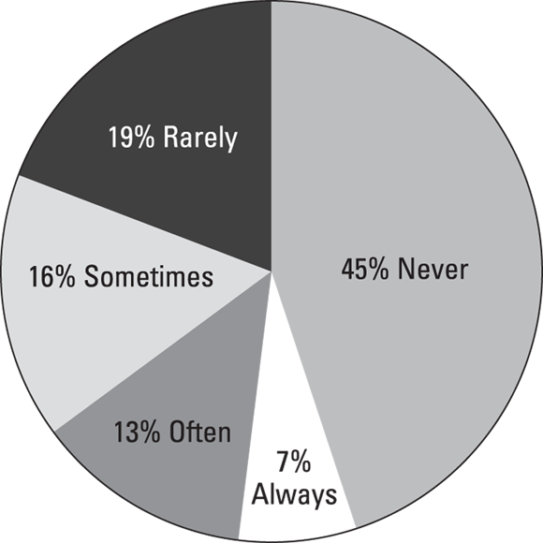
The problem with Status Quo
Traditional projects that do succeed often suffer from scope bloat.
The numbers in Figure illustrate an enormous waste of time and money.
Direct result of traditional project management processes that are unable to accommodate change.
Project managers and stakeholders at the start of a project ask for :
Everything they need
Everything they think they may need,
Everything they want,
Everything they think they may want
Actual use of requested software features.
19-Jan-25
Agile Software Process SE SG544 S2-24-25
Copyright Standish Group

Slide 29
Project management Needed Makeover
In software development, everything changes. Requirements, skills, people, environment, business rules, et cetera.
As time progresses, you learn better techniques of doing things.
Your stakeholders need to change requirements to match changing organizational strategy or Technology trends or changing market conditions.
In other words, the only guaranteed thing is change and the shown process to refine our work.
Software development is inherently an iterative process and does not work like a Waterfall cycle.
Over emphasis on checklists and controls does not help because software development is human centric and is heavily dependent on judgment and creativity.
Software is not a product designed to be built by assembly lines.
Ref: Agile Project Management for Dummies - Mark C. Layton John Wiley & Sons - 2012
19-Jan-25
Agile Software Process SE SG544 S2-24-25

Slide 30
Definable Work
Definable work projects are characterized by clear procedures that have proved successful on similar projects in the past.
The production of a car, electrical appliance, or home after the design is complete are examples of definable work.
The production domain and processes involved are usually well understood and there are typically low levels of execution uncertainty and risk.
Definable work is automated.
Ref: Agile Practice Guide (ENGLISH) Published by Project Management Institute, 2017 (Agile methodologies)
19-Jan-25
Agile Software Process SE SG544 S2-24-25

Slide 31
High Uncertainty Work
New design, problem solving, and not-done-before work is exploratory. It requires subject matter experts to collaborate and solve problems to create a solution.
Examples of people encountering high-uncertainty work include software systems engineers, product designers, doctors, teachers, lawyers, and many problem-solving engineers.
High-uncertainty projects have high rates of change, complexity, and risk.
These characteristics present problems for traditional predictive approaches that aim to determine the bulk of the requirements upfront and control changes through a change request process.
Instead, agile approaches were created to explore feasibility in short cycles and quickly adapt based on evaluation and feedback.
Ref: Agile Practice Guide (ENGLISH) Published by Project Management Institute, 2017 (Agile methodologies)
19-Jan-25
Agile Software Process SE SG544 S2-24-25

Slide 32
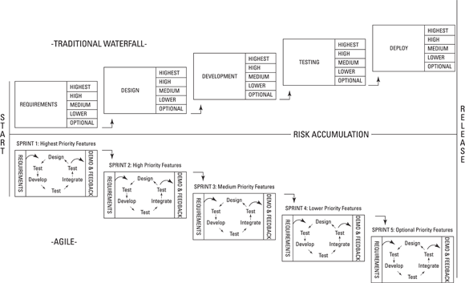
Waterfall vs agile project
Mixing traditional project management methods with agile approaches:
The answer, of course, is you can. If you fully commit to an agile approach, you will have a better chance of deriving benefits of Agile project
Ref: Agile Project Management for Dummies - Mark C. Layton John Wiley & Sons - 2012
19-Jan-25
Agile Software Process SE SG544 S2-24-25

Slide 33
Evolution of Agile Project Management
19-Jan-25
Agile Software Process SE SG544 S2-24-25

Slide 34
Agile Project Management
Agile project management is a style of project management that focuses on :
Early delivery of business value
Continuous improvement of the project’s product and processes
Scope flexibility
Team input
Delivering well-tested products frequently that reflect customer needs.
19-Jan-25
Agile Software Process SE SG544 S2-24-25

Slide 35
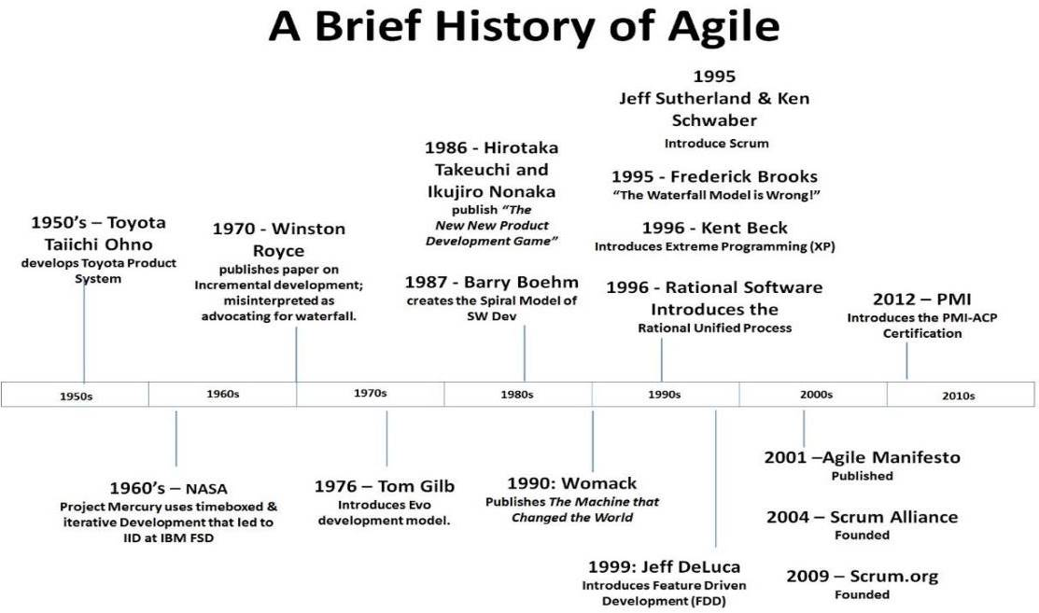
Evolution of Agile Frameworks
Source Material e-learn(Recorded)
19-Jan-25
Agile Software Process SE SG544 S2-24-25

Slide 36
Evolution of Agile Frameworks …
In 1986, Hirotaka Takeuchi and Ikujiro Nonaka published an article called “New New Product Development Game” in the Harvard Business Review.
Takeuchi and Nonaka’s article described a rapid, flexible development strategy to meet fast-paced product demands.
This article first paired the term scrum with product development. (Scrum originally referred to a player formation in rugby.)
Scrum eventually became one of the most popular agile project management frameworks.
19-Jan-25
Agile Software Process SE SG544 S2-24-25

Slide 37
Evolution of Agile
In 2001, a group of software and project experts got together to talk about what their successful projects had in common.
This group created the Agile Manifesto, a statement of values for successful software development:
We will see more details about Agile Manifesto in the next Module
19-Jan-25
Agile Software Process SE SG544 S2-24-25

Slide 38
Why Agile Projects Work Better
The Standish Group study, mentioned earlies slide “Software project success and failure,” found that while 29 percent of traditional projects failed outright, that number dropped to only 9 percent on agile projects.
The decrease in failure for agile projects is a result of agile project teams making immediate adaptations based on frequent inspections of progress and customer satisfaction.
Ref: Agile Project Management for Dummies - Mark C. Layton John Wiley & Sons - 2012
19-Jan-25
Agile Software Process SE SG544 S2-24-25

Slide 39
Why Agile Projects Work Better …
Some key areas where agile approaches are superior to traditional project management methods:
Project success rates: The risk of catastrophic project failure falls to almost nothing on agile projects. Agile approaches of prioritizing by business value and risk ensure early success or failure. Agile approaches to testing throughout the project help ensure that you find problems early, not after spending a large amount of time and money.
Scope creep: Agile approaches accommodate changes throughout a project, minimizing scope creep. On agile projects, you can add new requirements at the beginning of each sprint without disrupting development flow. By fully developing prioritized features first, you prevent scope creep from threatening critical functionality.
Inspecting and adaptation: Agile project teams — armed with frequent feedback from complete development cycles and working, shippable functionality — can improve their processes and their products with each sprint.
Ref: Agile Project Management for Dummies - Mark C. Layton John Wiley & Sons - 2012
19-Jan-25
Agile Software Process SE SG544 S2-24-25

Slide 40
Agile Project Management Framework
19-Jan-25

Slide 41
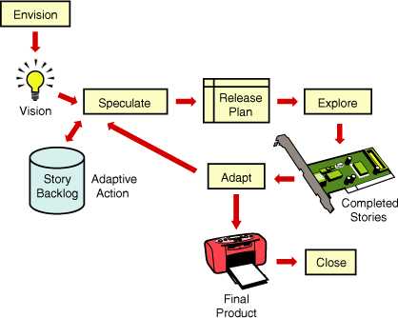
Agile Delivery Framework (APM)
Envision: Determine the product vision and project objectives and constraints, the project community, and how the team will work together
Speculate: Develop a capability and/or feature-based release plan to deliver on the vision
Explore: Plan and deliver running tested stories in a short iteration, constantly seeking to reduce the risk and uncertainty of the project
Adapt: Review the delivered results, the current situation, and the team’s performance, and adapt as necessary
Close: Conclude the project, pass along key learnings, and celebrate.
The departure from traditional phase names—such as Initiate, Plan, Define, Design, Build, Test—is significant.
19-Jan-25

Slide 42
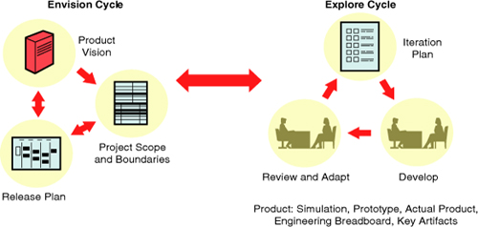
APM’s Envision and Explore Cycles
19-Jan-25

Slide 43
Benefits & Challenges of Agile Methods
19-Jan-25
Agile Software Process SE SG544 S2-24-25

Slide 44
Corporate World - Challenges and Inefficiencies
Most organizations (Small/Large/Public/Private/Startup) share the same core challenges and inefficiencies, including:
Missed (or rushed) deadlines.
Budget blow-outs
Overworked and stressed employees.
Knowledge silos.
Technology innovations and Agile approaches that have enabled them: (IT & Manufacturing industries)
Genuinely create more efficient work environments, to consistently manage their work within allocated budgets, and to regularly deliver high business-value (and high-quality) outputs on time.
19-Jan-25
Agile Software Process SE SG544 S2-24-25

Slide 45
Benefits of Agile Methods/Approaches/Practices/Techniques
Responsive planning: involves breaking down long-term objectives into shorter delivery cycles; and then adapting ongoing work (and funding) based on the outcomes of each delivery cycle.
Business-value-driven work: involves prioritizing work in accordance with the amount of primary and secondary business value that each activity is likely to bring to the organization.
19-Jan-25
Agile Software Process SE SG544 S2-24-25

Slide 46
Benefits of Agile Methods/Approaches/Practices/Techniques …
Hands-on business outputs: involves regularly inspecting outputs firsthand in order to determine whether business requirements are being met – and whether business value is being delivered for the organization.
Direct stakeholder engagement: involves actively engaging internal and external customers throughout a process to ensure that the resulting deliverables meet their expectations.
19-Jan-25
Agile Software Process SE SG544 S2-24-25

Slide 47
Benefits of Agile Methods/Approaches/Practices/Techniques …
Immovable deadlines: are fixed time commitments that encourage staff members to deliver regular ongoing value to the organization.
Management by self-motivation: involves using the power of self-organized teams to deliver outcomes under the guidance and oversight of the customer.
‘Just-in-time’ communication: replaces traditional corporate meetings with techniques for more effective communication and knowledge transfer (Differ Commitment)
19-Jan-25
Agile Software Process SE SG544 S2-24-25

Slide 48
Benefits of Agile Methods/Approaches/Practices/Techniques …
Immediate status tracking: provides tools that enable staff to keep others in the organization continuously aware of the status of the work that they are doing.
Waste management: involves maximizing the value of the organization’s resources by reducing and, where possible, eliminating low business-value activities.
Constantly measurable quality: involves creating active checkpoints where organizations can assess outputs against both qualitative and quantitative measurements.
19-Jan-25
Agile Software Process SE SG544 S2-24-25

Slide 49
Benefits of Agile Methods/Approaches/Practices/Techniques …
Rearview mirror checking: provides staff with tools for regularly monitoring and self-correcting their work.
Continuous improvement: involves regularly reviewing and adjusting business activities to ensure that the organization is continuing to meet market and stakeholder demand.
19-Jan-25
Agile Software Process SE SG544 S2-24-25

Slide 50
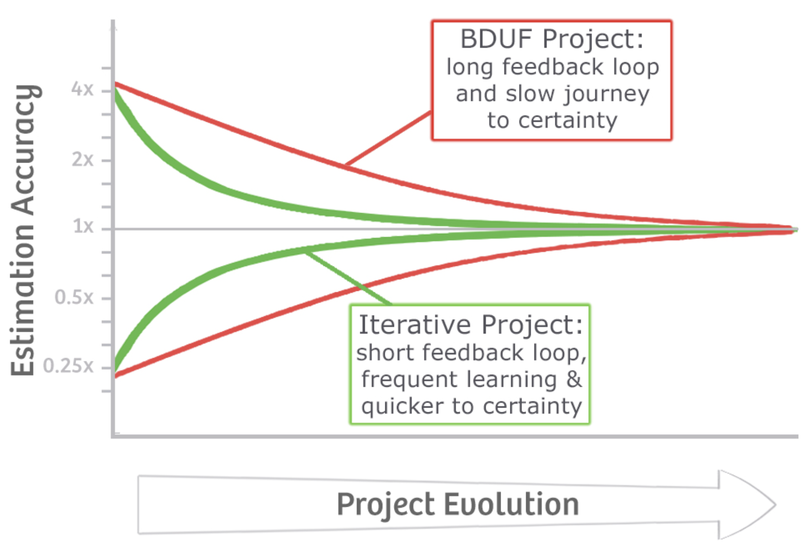
Cone of Uncertainty
BDUF- Big Design Up Front
Waterfall Approach
Emergent Design
Agile Approach
Reference/: https://agilecoffee.com/wp-content/uploads/2016/12/07-cone-of-uncertainty.jpg
17-Jul--24
Agile Software Processes SE ZG544 S2-24-25

Slide 51
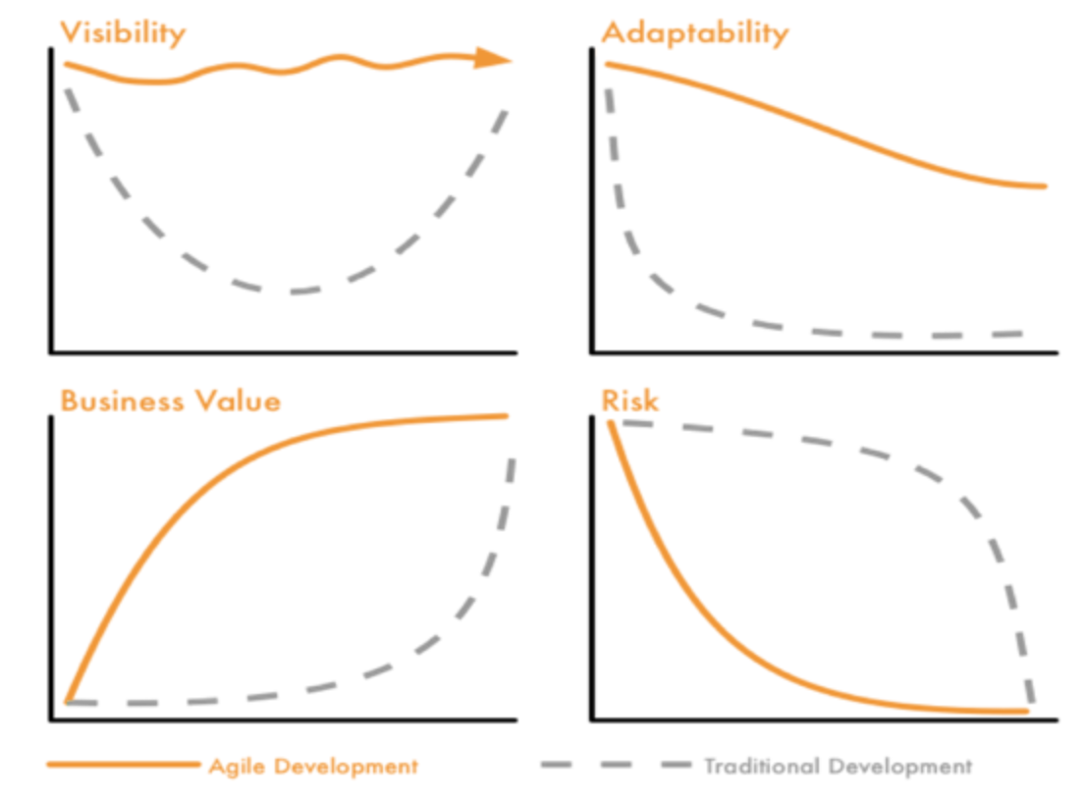
Other benefits of agile approach
Reference: https://www.beyond20.com/blog/when-to-use-agile-and-when-to-use-waterfall-when-managing-projects
19-Jan-25
Agile Software Processes SE ZG544 S1—24-25

Slide 52
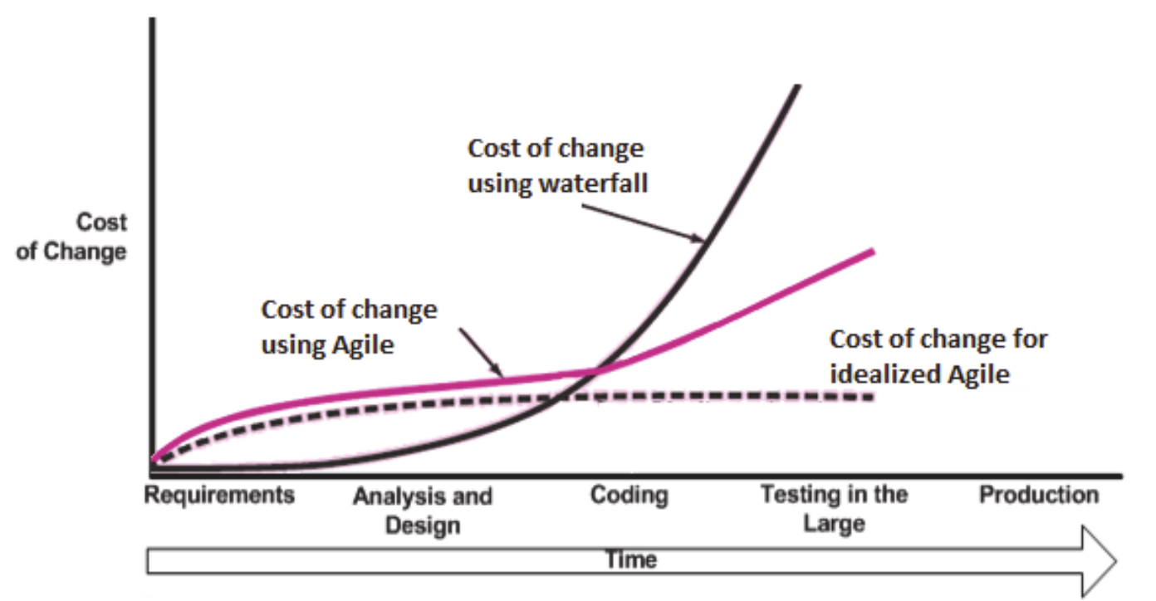
Cost of change
Ref: https://www.researchgate.net/figure/Cost-change-curve-of-traditional-and-agile-methodology-23_fig9_312564218
19-Jan-25
Agile Software Processes SE ZG544 S2-24-25

Slide 53
Thank you
19-Jan-25
Agile Software Process SE SG544 S2-24-25

